Slide 1
CSE315:Introduction to Data Science Fall 2024
WEEK-1
Lesson 1

Slide 2
Data Science
Data science is a collection of techniques used to extract value from data. Data science techniques rely on finding useful patterns, connections, and relationships within data. Data science is also commonly called knowledge discovery, machine learning, predictive analytics, and data mining. However, each term has a slightly different connotation depending on the context.
Data vs Information
Data is raw, unorganized, unprocessed information, while information is processed, organized, and interpreted to add meaning and value.
Example: A sequence of numbers “100, 150, 200” is just data. However, if you put it into context: “The sales of a product over the past three months were 100, 150, and 200 units,” it becomes information because it provides meaning and value.

Slide 3
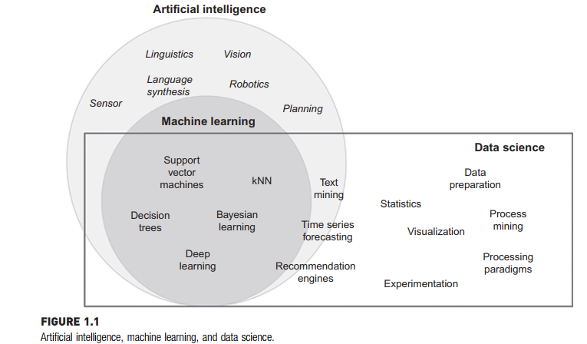
AI, ML and Data Science: Artificial intelligence, Machine learning, and data science are all related to each other. All of these three fields are distinct depending on the context. Fig. 1.1 shows the relationship between artificial intelligence, machine learning, and data science

Slide 4
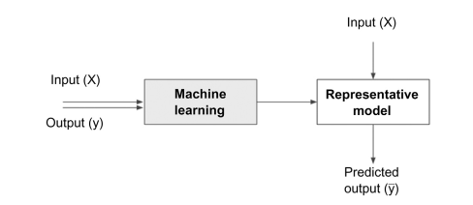
Building Representative models (Data Science Models)
A model is the representation of a relationship between variables in a dataset.
It describes how one or more variables in the data are related to other variables.
Data science is the process of building a representative model that fits the observational data.
The above figure shows the process of generating a model

Slide 5
Associated fields of Data Science
Data science covers a wide set of techniques, applications, and disciplines, there a few associated fields that data science heavily relies on. The fields are:
Descriptive Statistics
Exploratory visualization
Dimensional slicing
Hypothesis Testing
Data engineering
Business intelligence

Slide 6
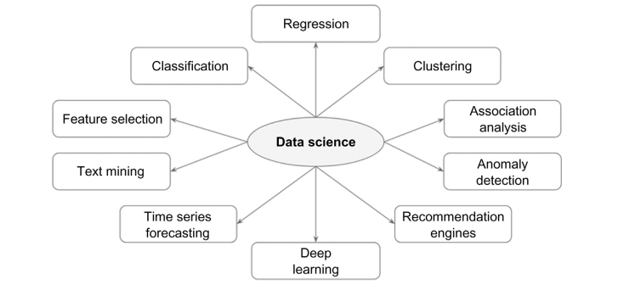
Data Science Tasks
Data science problems can also be classified into tasks such as: classification, regression, association analysis, clustering, anomaly detection, recommendation engines, feature selection, time series forecasting, deep learning, and text mining, etc.

Slide 7
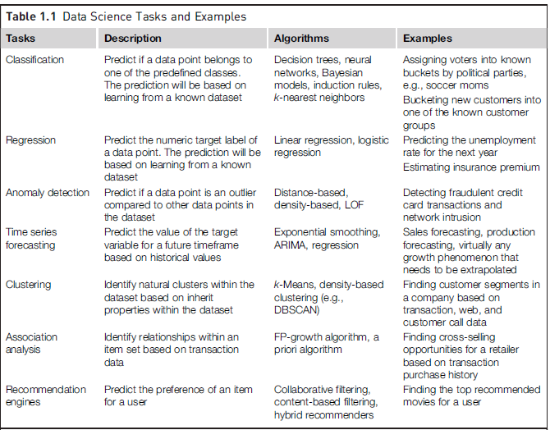

Slide 8
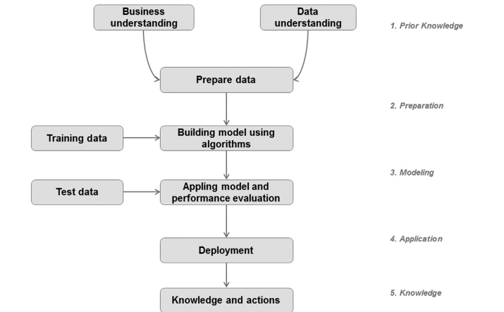
Data Science Process: The systematic discovery of useful relationships and patterns in data is enabled by a set of iterative activities collectively known as the data science process. The standard data science process involves (1) understanding the problem, (2) preparing the data samples, (3) developing the model, (4) applying the model on a dataset to see how the model may work in the real world, and (5) deploying and maintaining the models.

Slide 9
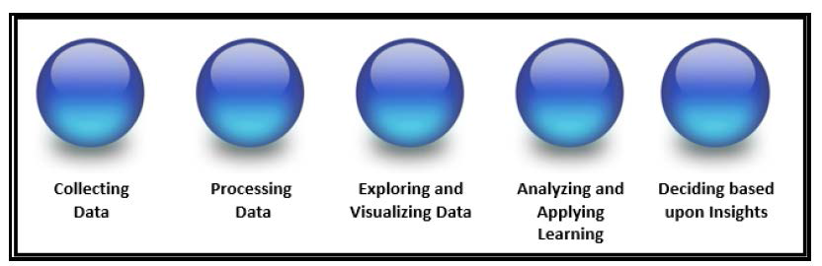
Key objectives of Data Science
• Collecting data
• Processing data
• Exploring and visualizing data
• Analyzing data and/or applying machine learning (to data)
• Deciding or planning based on acquired insight

Slide 10
Steps of Data Science Lifecycle
• 1 – Problem Identification and Understanding the problem.
• 2 – Data Collection (Web servers, Logs, Database, Online repository, etc.)
• 3 – Data Preparation, Cleaning, Transformation
• 4 – Data Modeling and Analysis (KNN, Decision tree, etc.)
• 5 – Model Evaluation and Interpretation of Results.
• 6 – Deployment and Communication of Findings.

